Slide 1
Coaching & Co-Branding [Module 4]
How to Create a Private White Label Coaching Program to Make it Easier to Sell Your High End Programs And Open up Hundreds of New Markets for Your IP
Notes:
1

Slide 2
What are we Covering in Module 4?
Quick Review of the Legal Framework for maximizing your company’s IP.
Pre-Certification Teaching & Accelerated Learning Concepts
36 principles of accelerated learning to incorporate in your training
Use accelerated learning in your interviews (7 Positioning Questions to Maximize Your Influence)
An Introduction into Business Process Design to incorporate in your training and certification

Slide 3
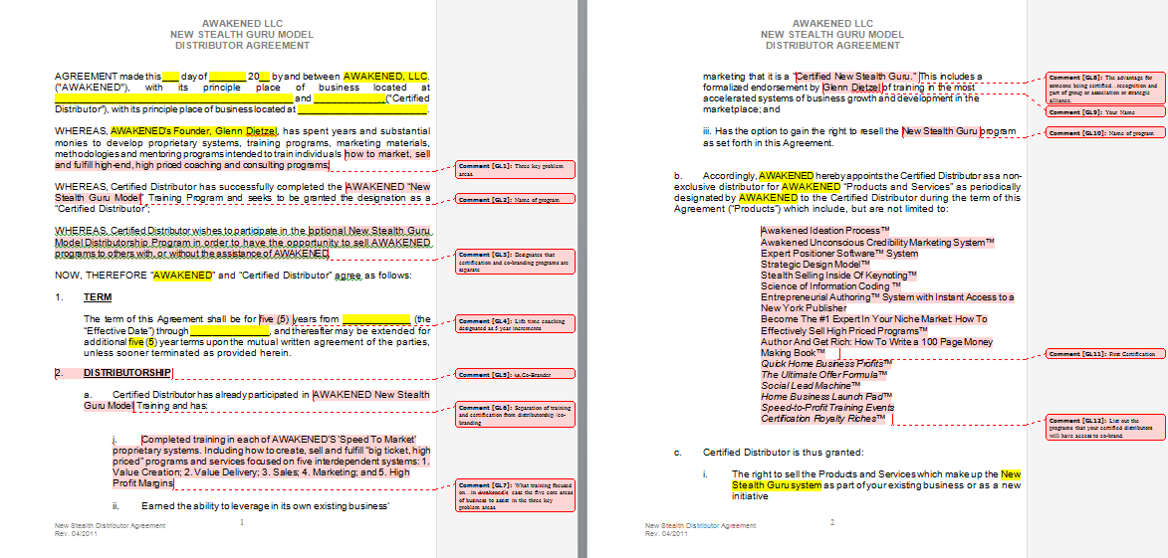

Slide 4
Pre-Certification & Accelerated Learning
Selling is Teaching.
Good teaching is recognizing the problem.
Focus is on the 'discovery' of the problem.
Multiple solutions are possible. Teach in a way to anchor the name of your program and your solution.
Teaching focuses on the learner and his/her problems not on the teacher.
You can teach Attitudes, Skills and Knowledge. (Just ASK™)

Slide 5
Pre-Certification & Accelerated Learning
Learning is dynamic not static.
Kaizen is the philosophy of continuous improvement.
You learn by teaching. You learn by doing.
Action – take action – and the next step may not always be clear, but it becomes clearer as you move along.
Adopt the mindset of CAN… NOT CAN'T.
As learning or teaching is taking place the RULES establish themselves. In business the rules are the systems employed.

Slide 6
Pre-Certification & Accelerated Learning
There are always CHOICES. Use the Choices – Responsibility – Consequences philosophy where for every problem situation you can brainstorm for possible choices of actions; choose an action recognizing beforehand the possible Consequences knowing that the Responsibility for the choice and the consequence rests with the individual/group making the choice. The choice of doing nothing is still a choice with responsibilities and consequences.

Slide 7
Pre-Certification & Accelerated Learning
Analysis – get a clear picture of where you are RIGHT NOW! Do this often especially when beginning a renewal.
Activity idea to help establish the concept of building a system through rules and understanding that all activity can be looked at as a set of rules like a recipe for success. You could use describing the process of hitting a golf ball by writing down the steps (rules, guidelines, component parts...). You could also do this for anything like cooking fried eggs for example including "what makes your fried eggs so special" and differentiating yourself. Apply this skill to business.

Slide 8
Pre-Certification & Accelerated Learning
See yourself as a coach not a sales person.
Teach (and use) the concept of "chunking" to make a large task more manageable and doable.
To 'teach' others you must exemplify what you are teaching. For example if you are teaching flexibility in changing the system (rules) to others you must be doing it yourself. Otherwise you have no credibility. People will not do as they are told in do as I say not as I do mentality.

Slide 9
Pre-Certification & Accelerated Learning
Turn questions into open ended statements then brainstorm solutions, Learning HOW to learn is professional development. Learn to see problem solving as personal/professional development. It's on-the-job professional development. It's your attitude that makes the difference here.
Choose the best solution and do something.
True learning is learning how to do it yourself.

Slide 10
Pre-Certification & Accelerated Learning
Reflection is the key to the need for new learning. Reflection is a skill that can be learned. There are best practices for reflection becoming a part of your life.
The question is always WHY.
Teaching and learning is always a two way street.
You "sell" the idea that clients are capable of solving most of their problems with the expertise and experience they or their employees already possess.

Slide 11
Pre-Certification & Accelerated Learning
You can hire "skills" and "Knowledge" but successful entrepreneurs must bring the right attitudes to the situation. This is leadership. Leadership is about attitudes.
See yourself as a leader and emphasize the leadership component of a successful business person.
Systems add value to anything. You can sell systems (businesses). Ultimately that's what a business is – a system that solves problems.

Slide 12
Pre-Certification & Accelerated Learning
Reflection leads to identifying Problems which leads to Questions that must be answered using Open Ended Statements that generate Choices for Action followed by Reflection on the consequences of the actions and around and around we go on a merry go round of Continuous Improvement (Kaizen). NOTE: This may become a working method of continuous assessment for self-assessment and external if done in a group. Just an idea.

Slide 13
Pre-Certification & Accelerated Learning
Certification is creating rules. Co-Branding is dealing with the rules.
Rules are static only as long as they work. Then rules become dynamic.
The best sources of solutions to problems are often the people working most closely with the problem. See employees (including owners, CEO, sales people, customers, business partners...) as providing solutions individually or collectively (groups).

Slide 14
Pre-Certification & Accelerated Learning
All input is good. Reflection and analysis in the choices, responsibility, consequences approach allows good choices to be made
Everyone loves to be "coached". Coaching is teaching. It facilitates learning with the student's involvement.
Start where the person (student, client, business owner, trainer, problem solver, certifier...) IS right now and MOVE THEM TO/THROUGH ACTION.

Slide 15
7 Positioning Questions to Maximize Your Influence
1. (WHY) What gives you the right to proclaim yourself as an expert in __________?
2. (WHAT) What is __________?
3. (WHY) Why is this relevant?

Slide 16
7 Positioning Questions to Maximize Your Influence
4. (HOW) How to __________ in ‘x’ easy steps?
NOTE: You can include a bonus step.
5. What if someone started with __________ what would their business and life look like in 30 days? 90 days? 1 year? 3 years?

Slide 17
7 Positioning Questions to Maximize Your Influence
6a. What are the specific roadblocks that typically prevent your students from getting started. (State top three.)
6b. What are three specific strategies that will assist your students to overcome these roadblocks. (Use Case Studies as an example.)
7. What’s the first physical action step you want a listener to take to get started with _______________.

