Slide 1
How to Create a Vetting Process Tied to an Irresistible Offer “Have Clients Sell Themselves to You.”

Slide 2
Key Points on Creating Your Vetting Process
Definitions:
Vetting: An educational process which you put potential candidates through to disqualify and qualify your ideal clients to sell themselves to you.
Bootcamps and One Day OMEGA MIND™ Intensives are macro vetting processes to have ideal candidates self select themselves to work with you.
Assessment instruments like the Profit Projector™ are micro vetting processes to have ideal candidates self select themselves to work with you.
Ideally five key criteria are a great way at creating ALLURE, anticipation and urgency to work with you.
Communicate the criteria in your consultative process, anchoring them in steps 1-7 of the consultative process and especially between Step 8 and 9 before sending the Executive Summary.
BONUS: Leverage the power of social proof in your Vetting Process.

Slide 4
1.0 NGM & the Law of Quantum Growth 2.0 NGM Stealth Persuasion Processes 3.0 NGM Mastermind Monetizer™ 4.0 NGM Stealth Training Systems 5.0 NGM Coaching and Co-Branding™ 6.0 OMEGA Mind powered by NGM
AGENDA

Slide 7
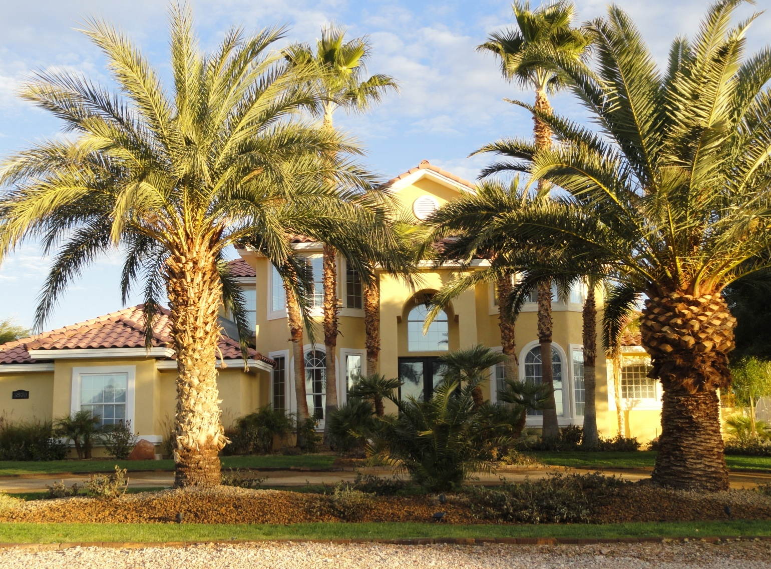
Notes:
7

Slide 8
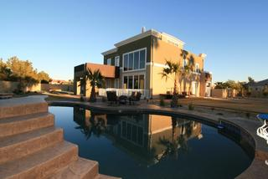
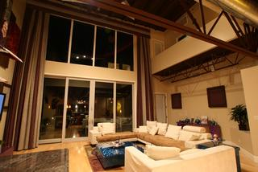
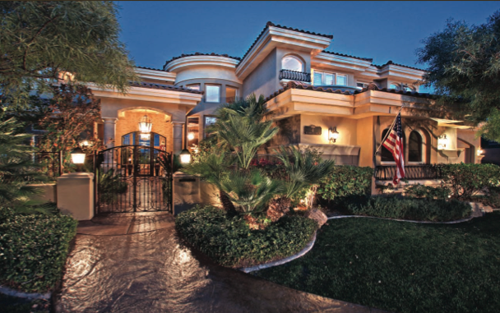
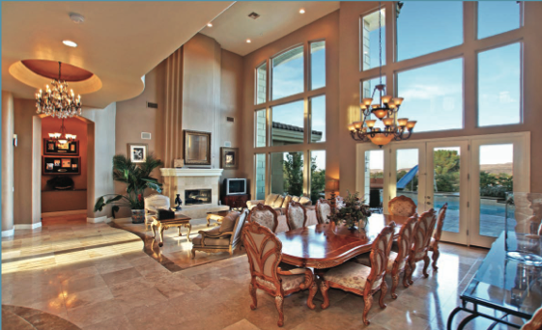

Slide 20
Attract high-end clients who pay high fees.
Work with fewer, bigger clients.
The big money is in coaching/consulting & masterminds.
1. Coaching & Co-Branding™
2. Mastermind Monetizer™

Slide 21
Leverage a new Royalty Revenue Model:
Layered Income which is…
Passive
Long Term
Cumulative

Slide 23
Work with Glenn for one year in the ultimate mastermind focused on pure execution.
Get both Certification & Co-Branding™ ($40k) + Mastermind Monetizer™ programs ($40k).
Four 3 Day events.
You get my certification and co-branding program where I assist you to create and sell them for $15k to $25k.

Slide 24
You will get video footage of you presenting to the group with testimonials from each group member.
Create your own high-end, exclusive intensives.
Each OMEGA MIND™ Member is personally vetted by Glenn.
Each OMEGA MIND™ Member will provide all members with access to their top business building system.

Slide 25
Featured in Lifestyle Entrepreneur Magazine™.
Build your company from the ultimate business acceleration model. (Create your own coaching/consulting & co-branding program.)
Access to Glenn’s Executive Mentoring Mastermind™ Program ($6K/month)
Access to Glenn’s Certification Royalty Riches™ Program ($10K)

Slide 27
EXCLUSIVE BONUSES:
Access to Glenn Dietzel’s private 2 day event in which he trained his own clients in his certification and co-branding process. ($15,000)
Access to Glenn’s certification action guide. ($5,000)
Access to Glenn’s proprietary systems which demonstrate how he leverages accelerated business growth and advanced teaching/learning processes so that you can model the same in your industry. (Priceless)

Slide 30
‘Speed-to-Market’ Consultation
Text omega to 248-469-4376
519.542.3043 (Awakened Int’l Office)

Slide 33
How to Get Case Studies That Close Your Deals. “And Have Clients Sell Themselves to You.”

Slide 34
5 Principles to Getting GREAT Case Studies
Use the Interview Client Action Plan – 10,000 hours of figuring out the best questions to ask and how to get referrals to boot.
Know the 7 Patterns of Buyer Resistance.
Pre-emptively eliminate buyer resistance. Know what will hold them back.
Make sure candidates for your coaching programs know they will be case studies. Reflect this in your Executive Summary.
Interview your clients on Google Hangouts to reflect the principles and your training in your consultative process (Steps 1-7).

Slide 35
The 7 Patterns of Buyer Resistance
The Looker. Resistance because they think they can get everything for free online.
The Expert. Resistance is based on appearing to be a ‘know-it-all’.
The Newbie-Startup. Resistance is based on feeling like they don’t have enough experience to fully begin.
The Procrastinator. Resistance based on over-thinking.
The Pretender. Resistance based on overwhelm. The quintessential non follow-through addict.
The Perfectionist. Resistance because can’t make fast decisions.
The Skeptic. Resistance because don’t believe the claims and feels too good to be true.

Slide 38
How to Create Clarity to Build an Irresistible offer. “And Have Clients Sell Themselves to You.”

