Slide 1
LEAD Generation: 20 Minute Coffee Consultation With High Flyers “Have Clients Sell Themselves to You.”

Slide 8
LEAD Generation: Email Initiation Template — How to Get Others to Refer You “Have Clients Sell Themselves to You.”

Slide 9
LEAD Generation: LinkedIn “Have Clients Sell Themselves to You.”

Slide 11
LEAD Generation: Create Your Own Online Media Channel Leveraging the Power of Google Hangouts “Have Clients Sell Themselves to You.”

Slide 18
LEAD Generation: PR Showcasing Your Leadership in Your Industry “Have Clients Sell Themselves to You.”

Slide 20
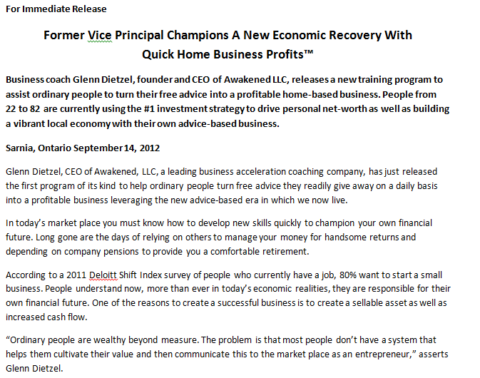

Slide 21
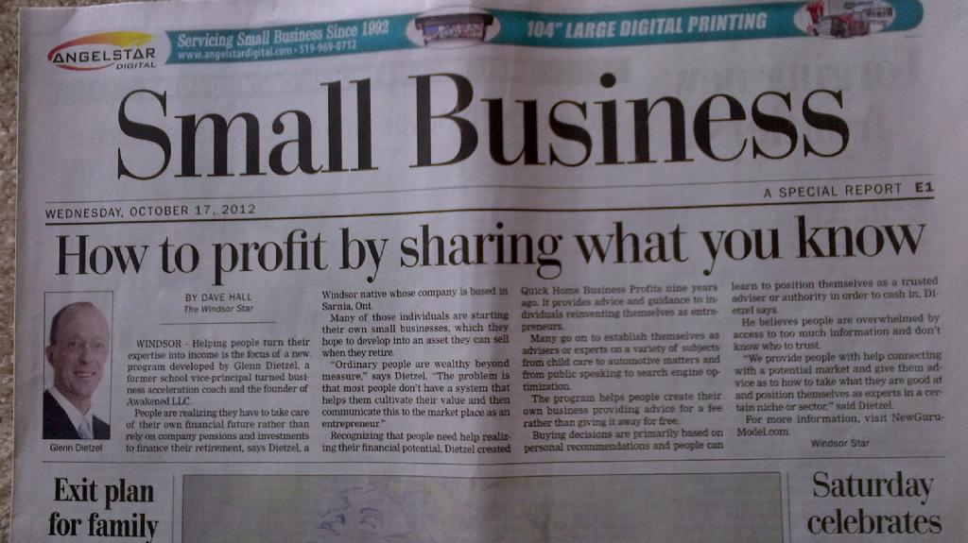

Slide 22
Stealth Persuasion Processes
Client Case Studies with Media.

Slide 23
People I’ve Impacted….
Client Case Study #2599: Eric Frey, U.S. Marine

Slide 24
“I sell $10,000 to $20,000 Programs with conversion rates of 60%! Glenn, that’s unheard of!”
Client Case Study #2599: Eric Frey, U.S. Marine

Slide 25
