Slide 1
How to Create Clarity to Build an Irresistible offer. “And Have Clients Sell Themselves to You.”

Slide 4
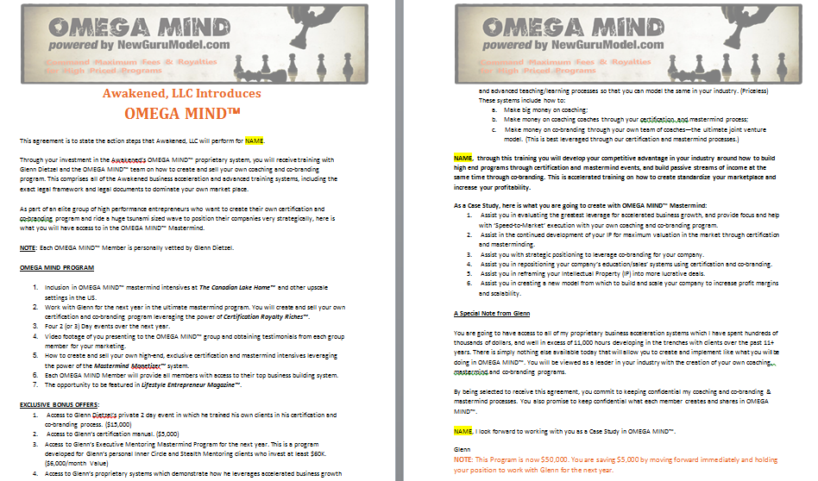

Slide 5
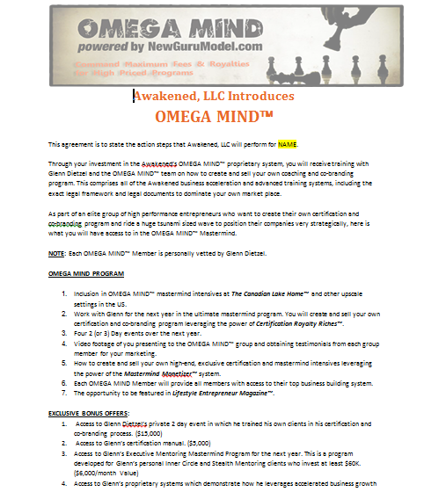

Slide 6
