Slide 1
LEAD Generation:
20 Minute Coffee Consultation With High Flyers
“Have Clients Sell Themselves to You.”

Slide 2


Slide 3
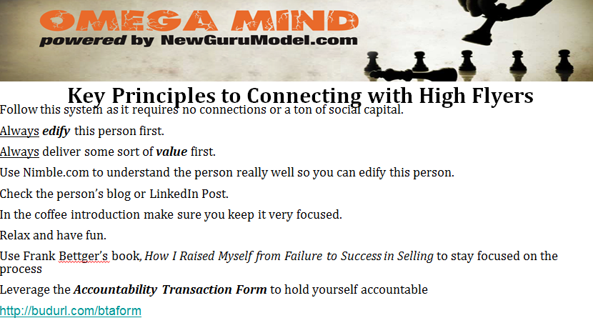

Slide 4
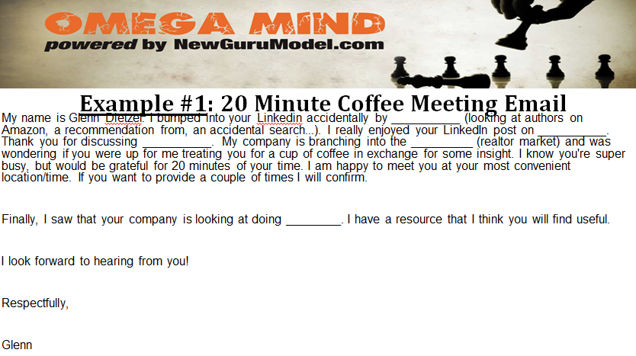

Slide 5
